Slide 1
Zipplo Data Project
Amina Imamovic
Dennis Sitnic
Lauri Immonen
Nuki Susanti

Slide 2
Introduction
Business scenario
Zipplo is an imaginary light vehicle rental company operating across Germany, Sweden and Finland, serving both private and corporate customers with electric mopeds, scooters, bicycles, and kickboards
Project overview
Design and implement an operational database to support the rental business process
Design a dimensional data warehouse (star schema) optimized for analytical reporting
Implement SQL-based ETL scripts to load the data warehouse from the operational database
Validate the system using rental transactions spanning six years of synthetic test data
Build Power BI reports to answer real business questions across time, equipment, location, and customer segments

Slide 3
Project Management
Adopted a Scrum-like project management framework
Product Backlog managed in Trello
One-week Sprint kicked off on Friday, May 29th with a joint backlog creation session and initial planning
Backlog broken down into four items, each divided into smaller tasks assignable to one or two team members
Each day started with a Daily standup to align and plan ahead
Tasks were typically completed in 1–2 hour focused sessions, followed by team syncs

Slide 4
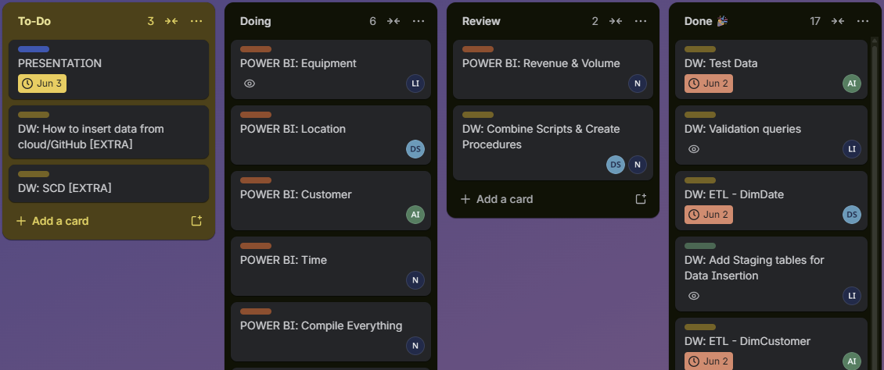
Project Management

Slide 5
Git & Documentation
https://github.com/nuki-susanti/zipplo-mini-project
GitHub used as the central repository for SQL scripts, Power BI reports and project documentation
Repository structure organized into three main areas: sql/operational/, sql/datawarehouse/ and reports/
Full README written to document the data model, ETL process and instructions for running the pipeline

Slide 6
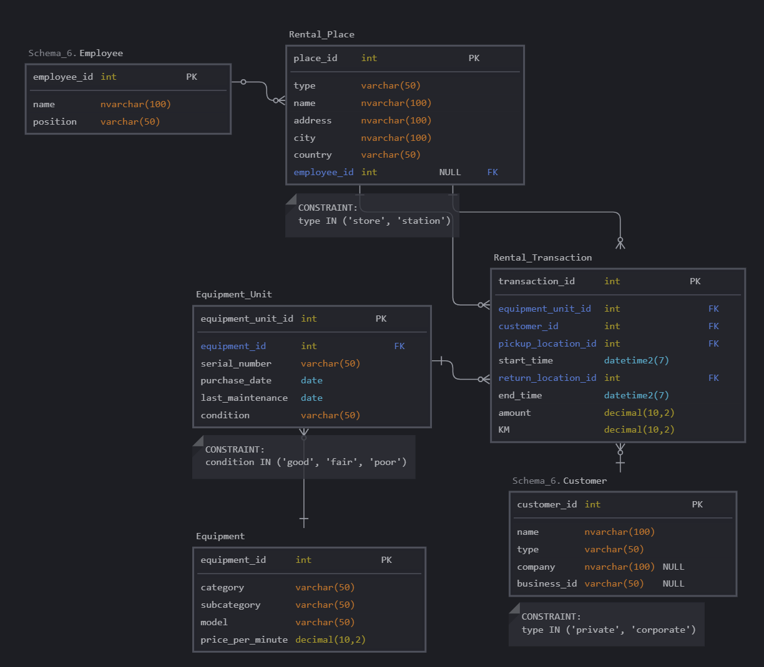
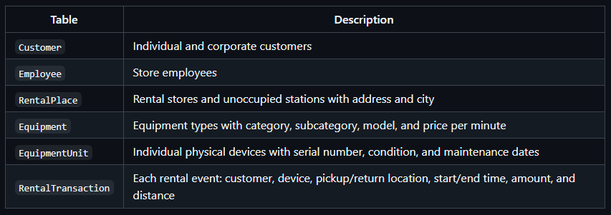
Operational Database - OLTP — ZipploDB
The source operational database (ZipploDB) is normalized and covers the following entities:
Key modeling decisions
Equipment vs EquipmentUnit — Equipment holds the type/model information shared across the fleet; EquipmentUnit represents each individual physical device. This cleanly separates catalog data from fleet management data.
RentalPlace covers both staffed stores and unstaffed stations using a type column, avoiding two separate tables for the same location concept.
Pricing is stored on Equipment as price_per_minute and applied against actual duration, keeping the billed amount in RentalTransaction fully auditable.

Slide 7
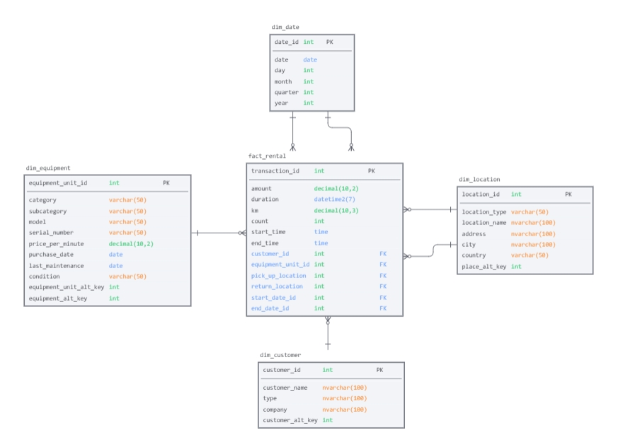
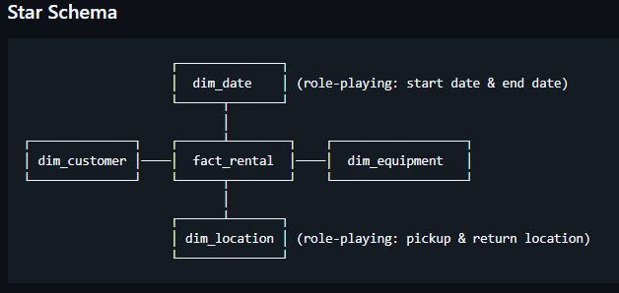
OLAP - Data Warehouse (ZipploDW)
The data warehouse follows a star schema with one central fact table and four dimension tables, optimized for analytical queries and Power BI reporting.
Fact table grain: One row per rental transaction.
Each row in fact_rental represents a single completed rental and stores foreign keys to all relevant dimensions plus the additive measures needed for analysis:
(rental) amount
duration (start time - end time)
km (rental distance)
count (rental count)

Slide 8




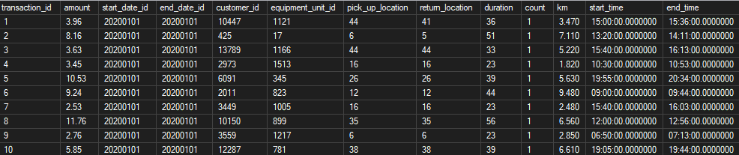
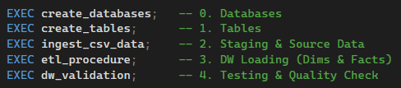
Flow Chart - Data Pipeline
bulk insert
data ingestion
ETL and
Validation
data consumption
csv files
Staging Tables
ZipploDB (OLTP)
ZipploDW (OLAP)
Report
Master Script for Automation

Slide 9
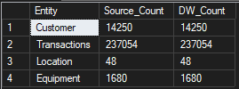


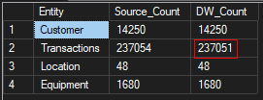

Validation
1. Row Count Check
(Source vs. Target)
2. Customer Totals
Discrepancy Check

Slide 10
What could we do better next time?
Consider naming conventions from the beginning
Leveraging the full potential of Git / GitHub

